Slide 1
Shortcuts from an Impatient DBA
Andy Mallon he/him

Slide 2

Andy Mallon
I make paste for a living
Database Reliability Engineer at Stack Overflow*
Working with SQL Server since 2003
Background in Tech Support, Database Administration, and Database Architecture
Lazy
Impatient
* The views & opinions expressed in this presentation are mine alone and do not reflect the views of my employer.

Slide 3








Notes:
Some of the things I love most in life– My husband, my pups, Queery the Diversity Dino.

Slide 4



Contact Andy
Andy@AMtwo.co
@AMtwo
am2.co/shortcuts
andy@am2.co

Slide 5

Session Feedback
Tell me what you don’t like
Tell me what can be better
Tell me what you like

Slide 6

I'm also gonna need you to go ahead and silence your mobile phones
Yea…….You apparently didn’t put one of the new coversheets on your TPS reports.

Slide 7
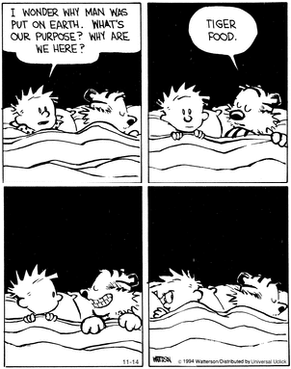
Why are we here?
This is a performance tuning session
We’re just tuning the other side of the keyboard
©1994 Bill Watterson

Slide 8
Agenda
SSMS Keyboard shortcuts
Other SSMS shortcuts & tricks
Windows Keyboard shortcuts
Other Windows shortcuts & tricks
Everyone should learn at least one thing!
Notes:
DBAs and Developers use Windows, too. We’re not going to pigeonhole ourselves by just looking at database stuff

Slide 9


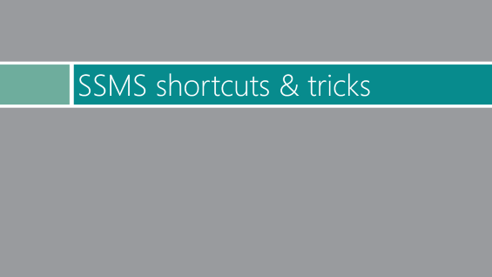
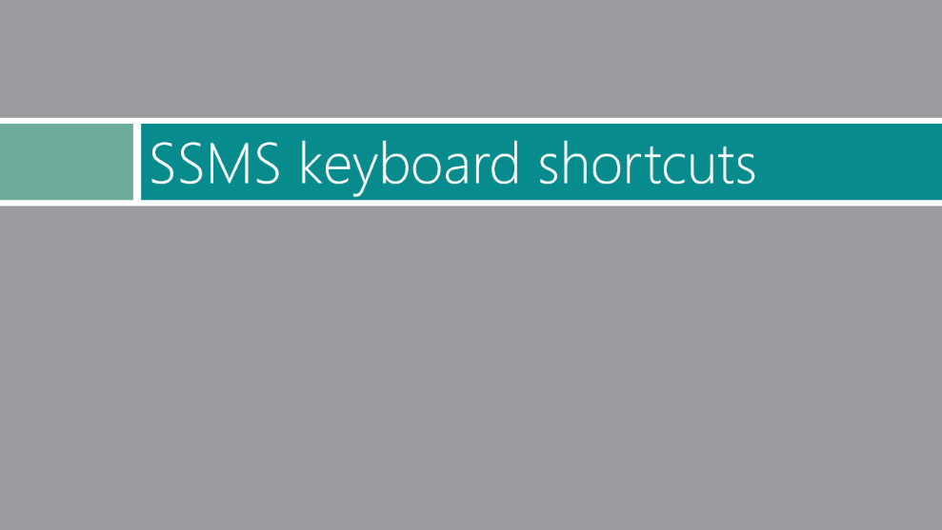





Slide 10
SSMS keyboard shortcuts

Slide 11
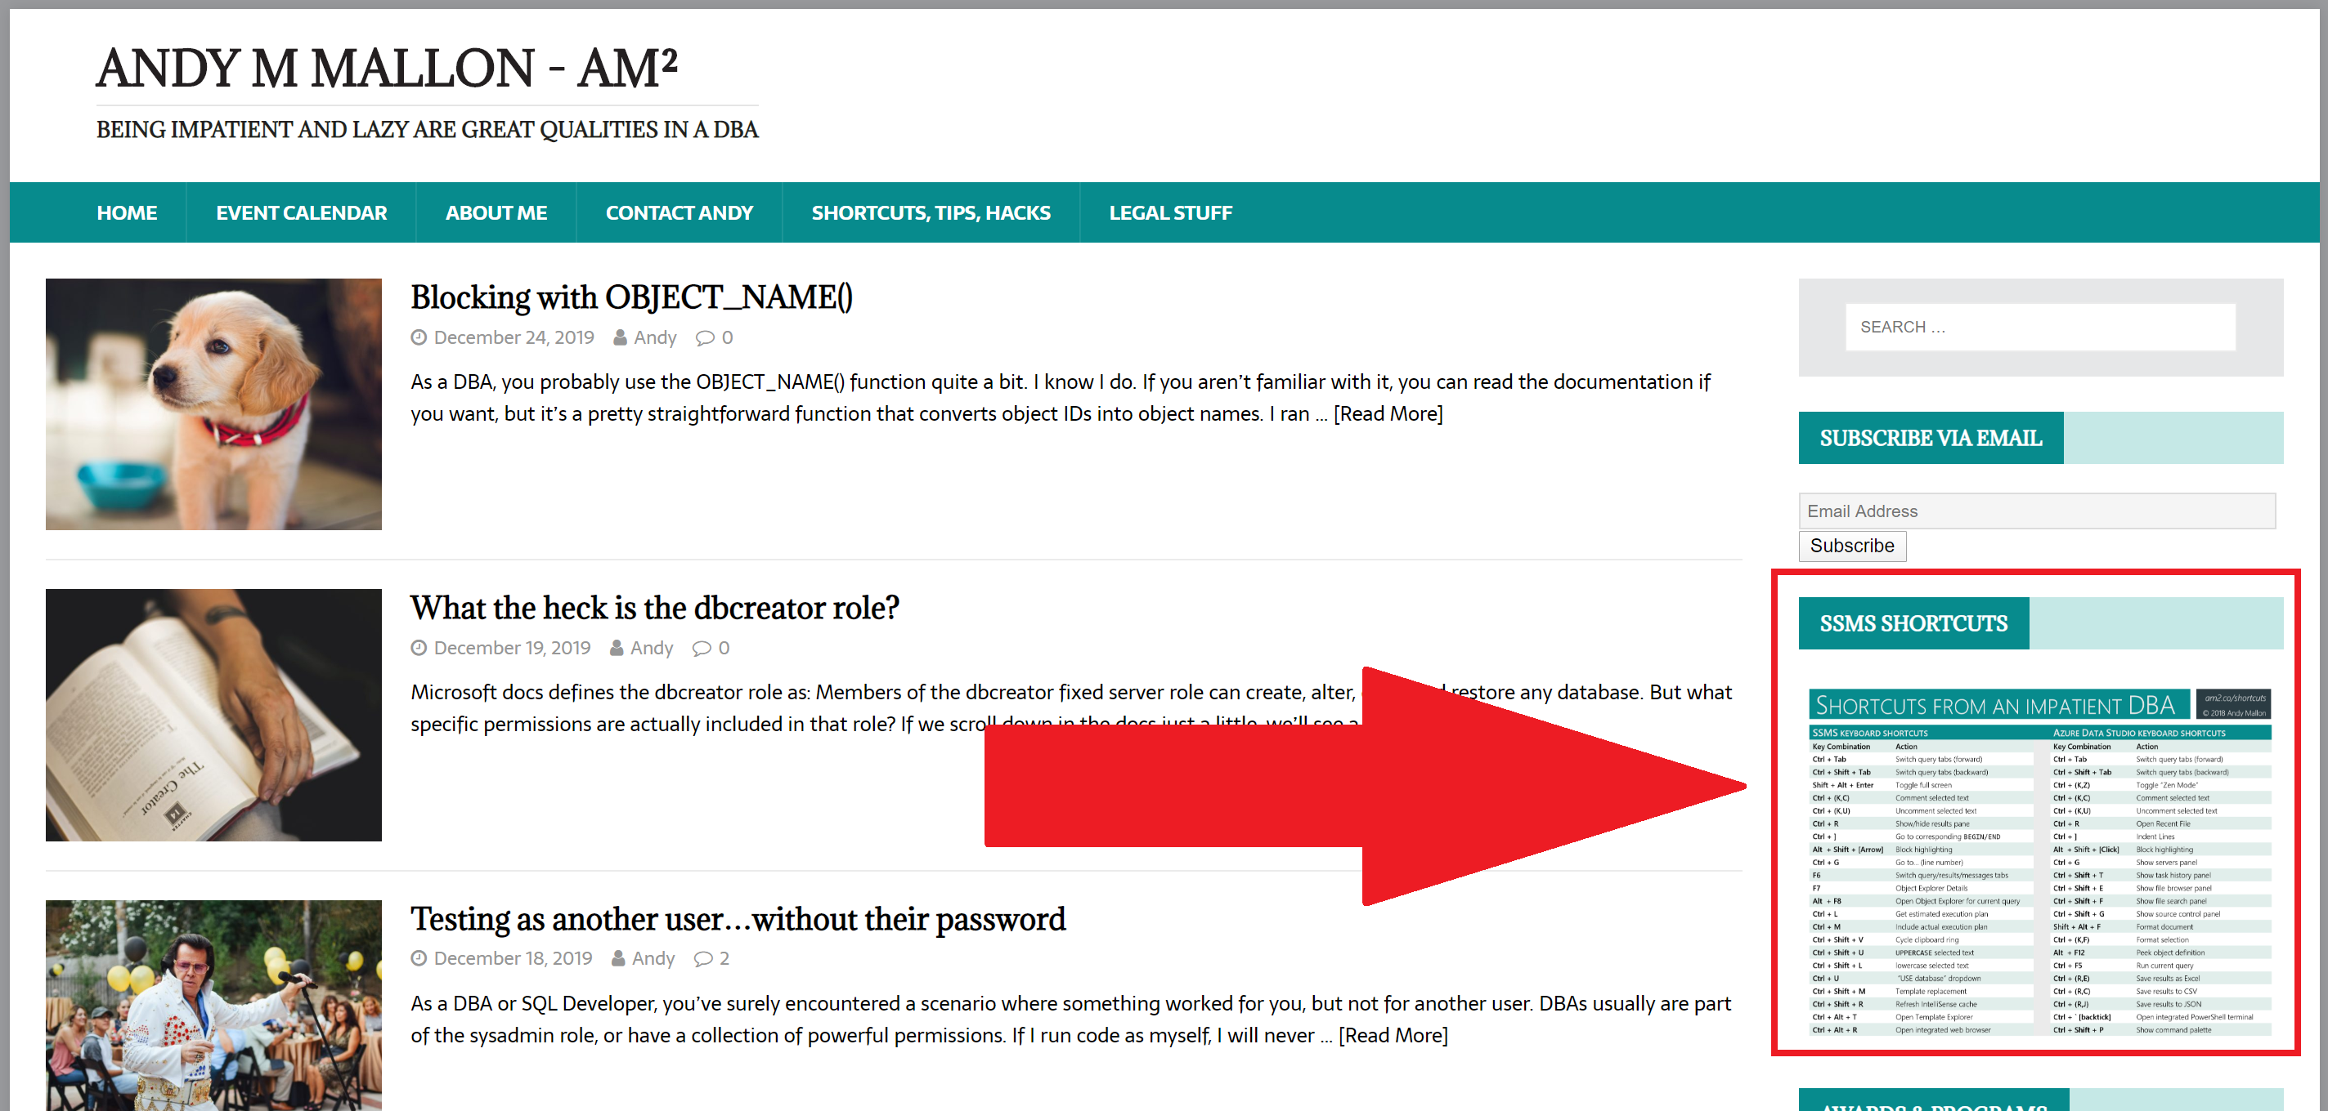

Slide 12
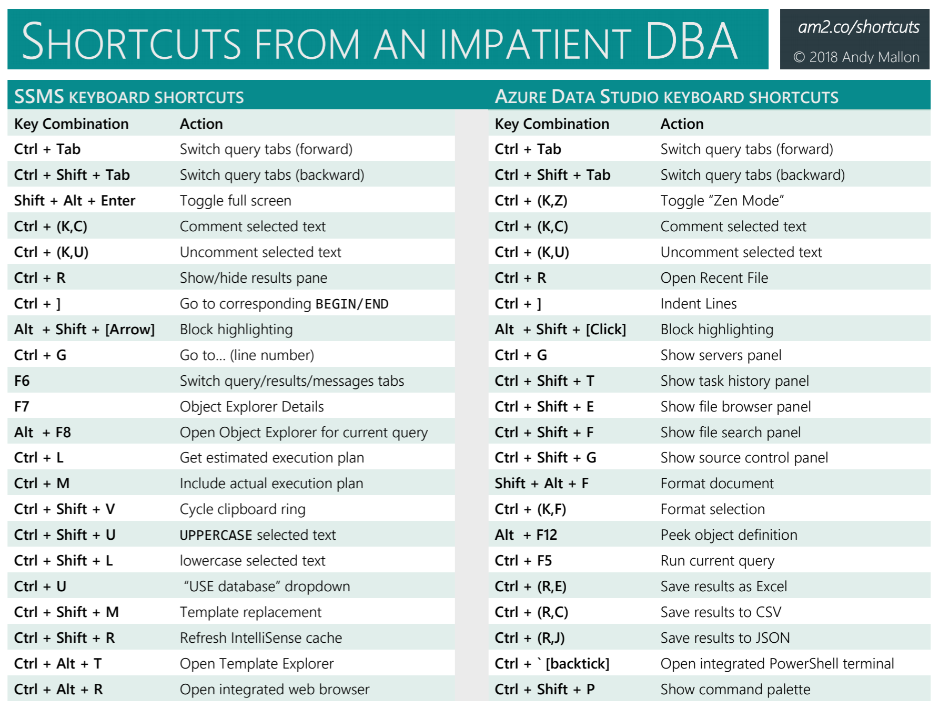

Slide 13
SSMS Keyboard shortcuts
(the ones you might already know)
Ctrl + (Shift +) Tab
Ctrl + R
Ctrl + L
Ctrl + M
Ctrl + (K,U) / Ctrl + (K,C)
Shift + Alt + Enter
Ctrl + U
Switch Tabs
Show/ hide Results pane
Get estimated execution plan
Include actual execution plan
Un/Comment selected text
Toggle full screen
Database-selection dropdown
Up, Up, Down, Down, Left, Right, Left, Right, B, A, Start
Notes:
POP QUIZ… One at a time, who knows what these do?

Slide 14

30 free lives
Notes:
Sorry, that one isn’t SSMS, its NES

Slide 15
More SSMS Keyboard shortcuts
(the ones you might not know)

Slide 16
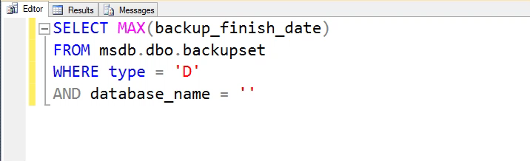
CTRL + SHIFT + V
Clipboard ring
Pasting the less-than-most-recent thing
Never lose something that only existed on your clipboard
Last 15 clipboard entries

Slide 17
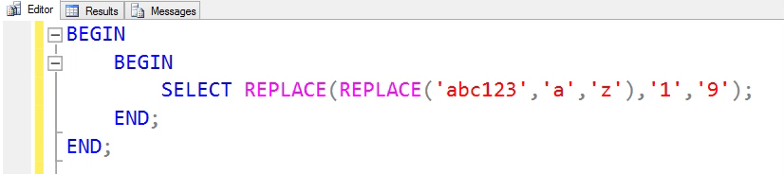
CTRL + ]
Go to BEGIN/END
Put cursor next to a BEGIN, then Ctrl + ] to bring you to corresponding END
Also works with parentheses, etc
Can be combined with SHIFT to highlight
Notes:
Can be combined with SHIFT to select

Slide 18
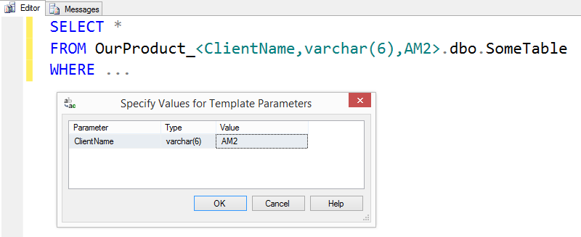
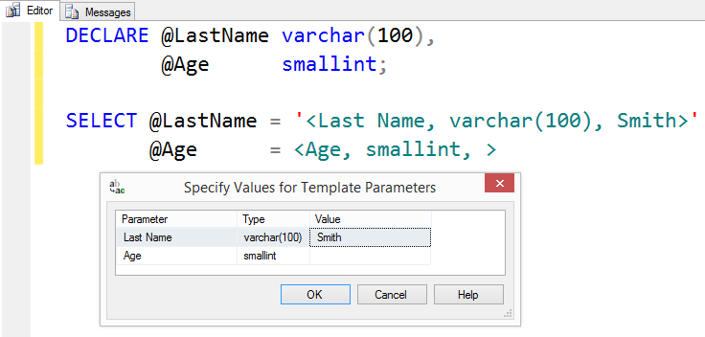
CTRL + SHIFT + M
Template Replacement
Using templates for saved/reusable scripts
<label, datatype, default value>
Notes:
Notice how the stuff in the quotes isn’t red!!
Especially great for multi-tenant hosting environment

Slide 19
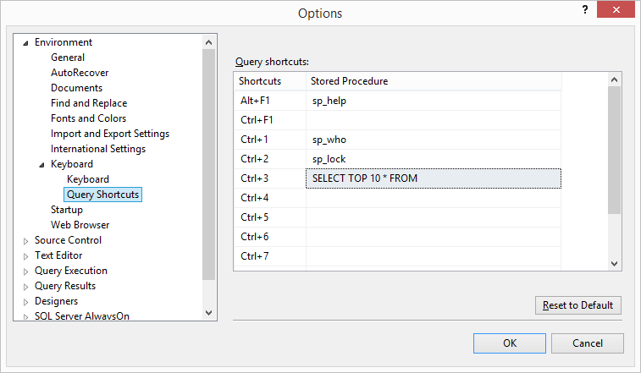
SSMS Query Shortcuts
3 Built-in, non-customizable
9 customizable shortcuts
Get to frequent queries quickly
Highlight text, then use shortcut key combination
SELECT TOP 10 * FROM
Highlight table name, hit Ctrl+3

Slide 20
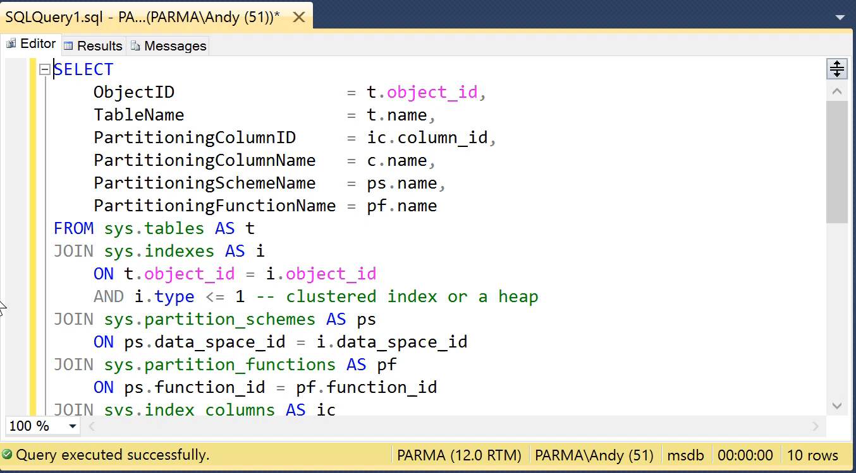
SSMS Query Shortcuts
3 Built-in, non-customizable
9 customizable shortcuts
Get to frequent queries quickly
Highlight text, then use shortcut key combination
SELECT TOP 10 * FROM
Highlight table name, hit Ctrl+3

Slide 21
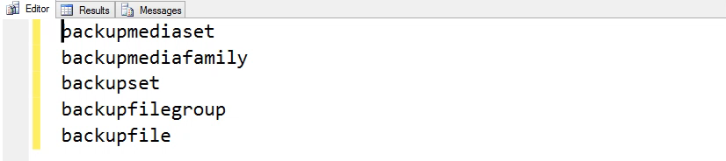
ALT + SHIFT + Arrow ALT + DRAG
Block highlighting / vertical highlighting
Easily edit a column of text

Slide 22
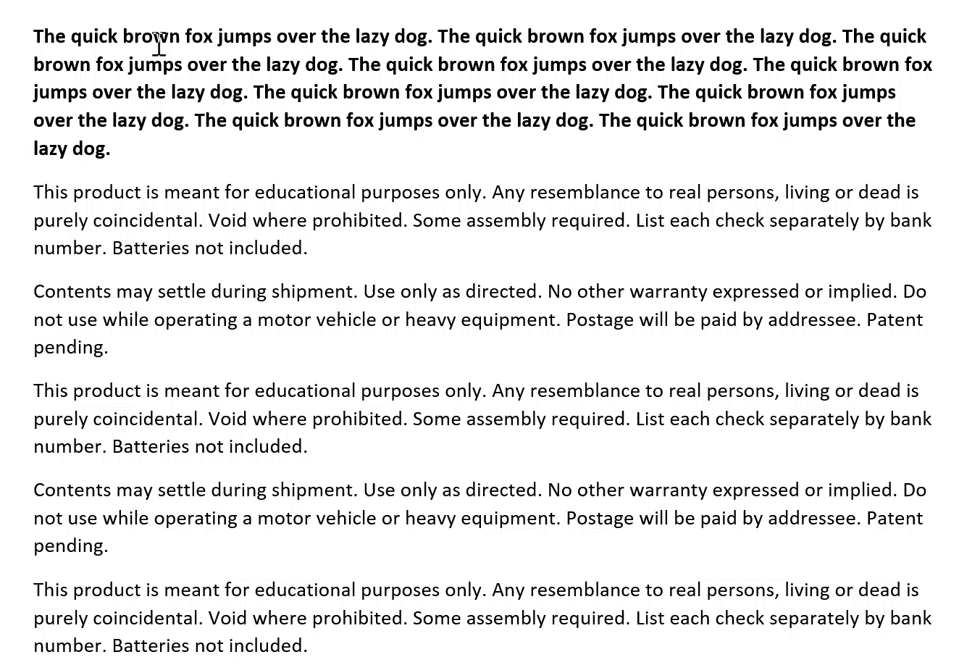
ALT + SHIFT + Arrow …In Microsoft Word

Slide 23
SSMS shortcuts & tricks

Slide 24
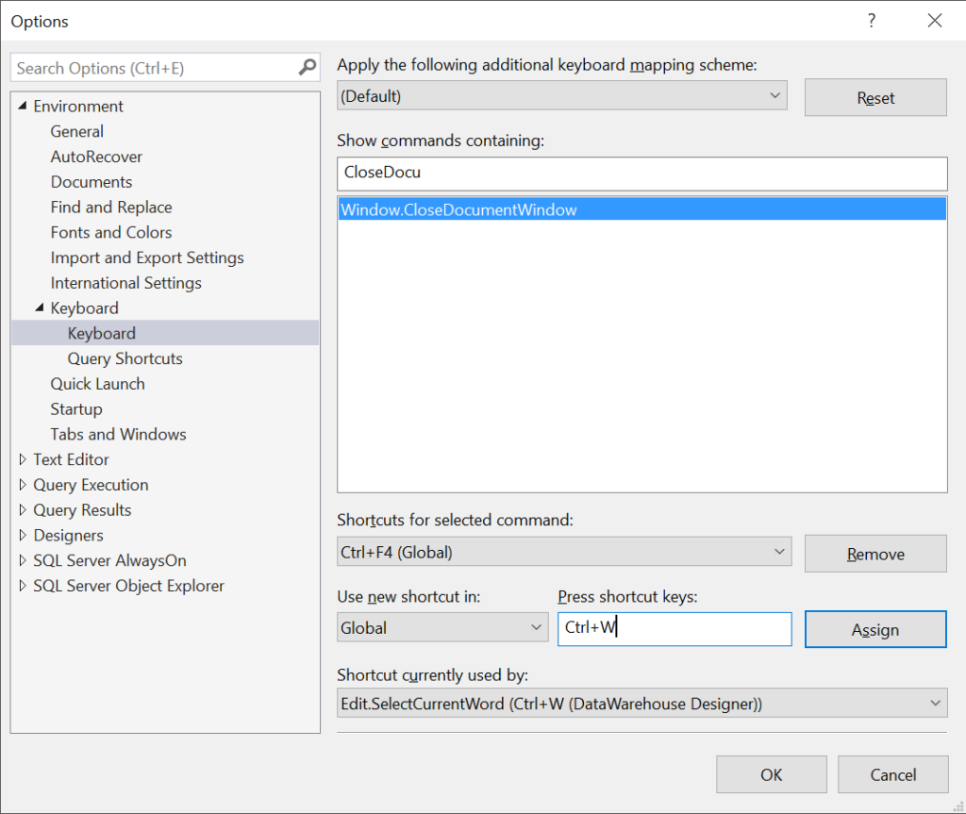
Remapping SSMS Shortcuts
You can customize keyboard shortcuts, for virtually every action in SSMS
am2.co/RemapSSMS

Slide 25
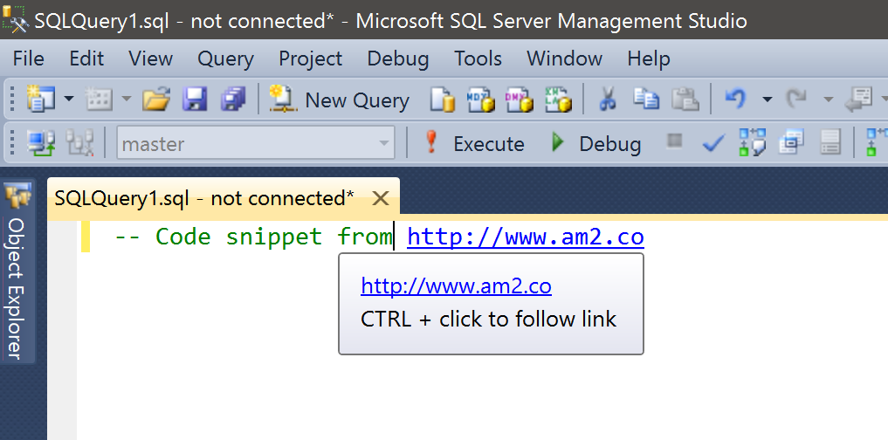
SSMS has a web browser built-in
URLs in your comments are clickable
Notes:
Works great for attribution of code that you grabbed from the interwebz
Also great for pointing at a wiki or internal documentation

Slide 26

Management Studio Drag
Drag-drop a tab in SSMS to re-order
Drag a tab out of SSMS to float/undock
Also Window→Float from the menu
Chrome, IE/Edge, and other apps with tabbed UIs offer similar behavior
Bianca del Rio Image from Lujon Magazine http://go.am2.co/1XKDbNR
Notes:
One difference between Chrome & SSMS is that dragging a tab OUT will create another full window of Chrome, complete with menu bars, etc. In SSMS, your tab literally floats outside the existing SSMS. Both your “main” SSMS and your floating tab are in focus at the same time

Slide 27
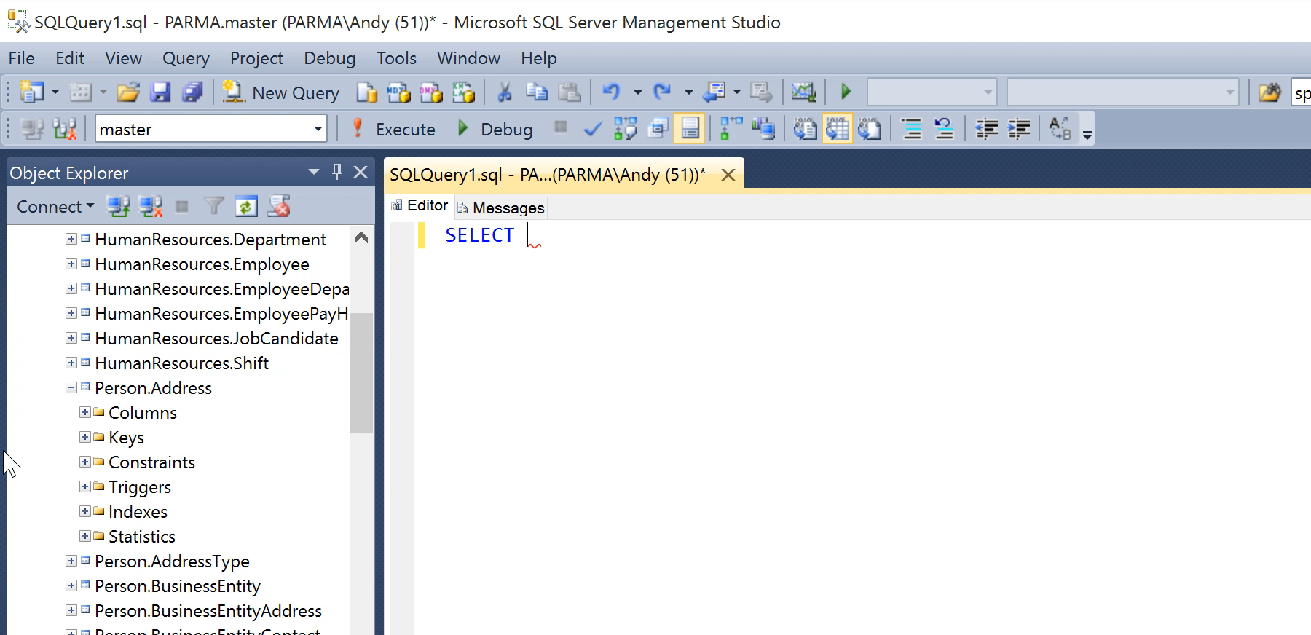
All the columns
Drag “Columns” folder from Object Explorer to list all column names
This doesn’t work with every folder in Object Explorer

Slide 28
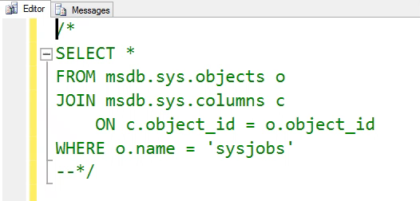
Comment out your comments
More easily comment/uncomment long comments
Use /* to start the comment, and --*/ to end
Comment out the start, and you un-comment the whole thing
No need to hunt for where the comment ends

Slide 29
Wild about wildcards
SELECT stuff FROM my.table WHERE stuff LIKE 'Thi%'
SELECT stuff FROM my.table WHERE stuff LIKE 'Thi_'
Multi-character wildcard
Single-character wildcard
stuff
This
This is a multi-character wildcard.
This is boring. I know this.
stuff
This

Slide 30
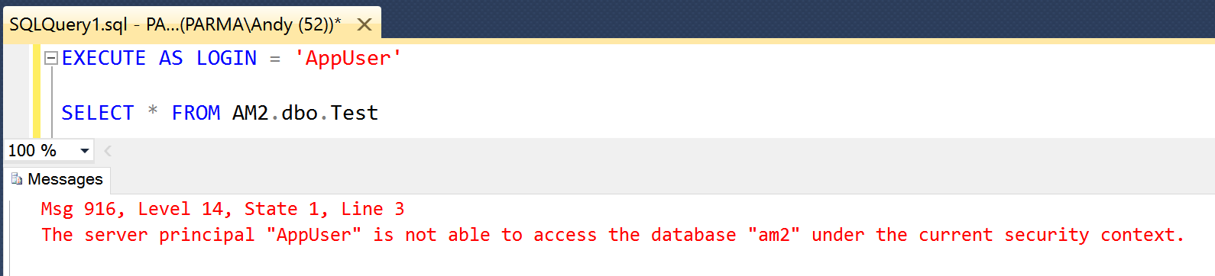
Execute code as a different user
EXECUTE AS LOGIN = 'LoginName'
Requires IMPERSONATE permission
GRANT IMPERSONATE ON LOGIN::[LoginName] TO [Impersonator]
Remember to REVERT
Notes:
This is HUGE for DBAs who are debugging permissions issues.

Slide 31
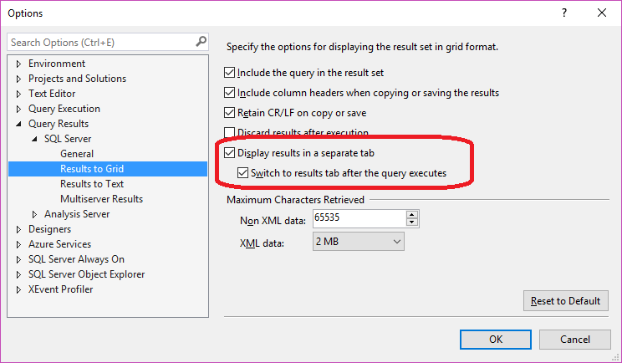
Results as separate tab
Results as separate tab, instead of results pane
F6 to switch between tabs
Ctrl+R to hide the results pane won’t work, because there’s no results pane
Good for when screen real estate matters
Laptop screen
Projector
Long queries
Notes:
You’ll see most presenters using this, but I love it anytime I’m working on my teeny tiny 13” laptop screen.
NOTE: This won’t affect tabs already open. You’ll need to open a new tab.

Slide 32
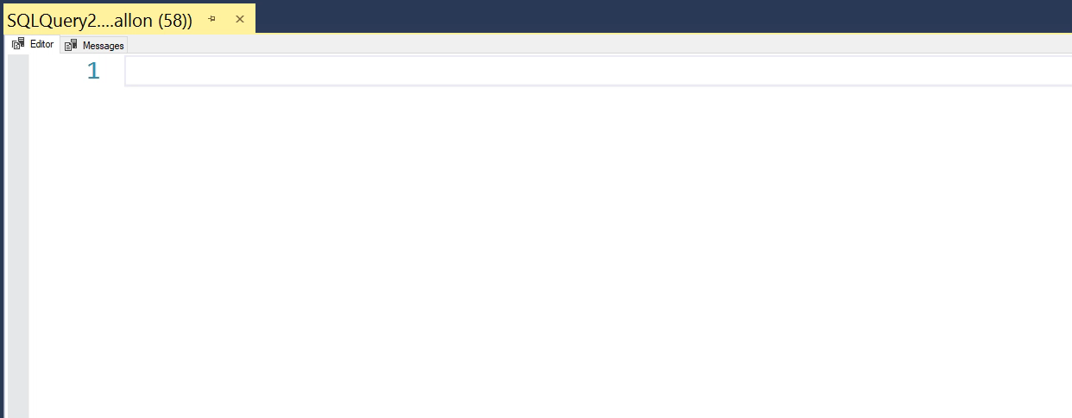
Results as separate tab

Slide 33
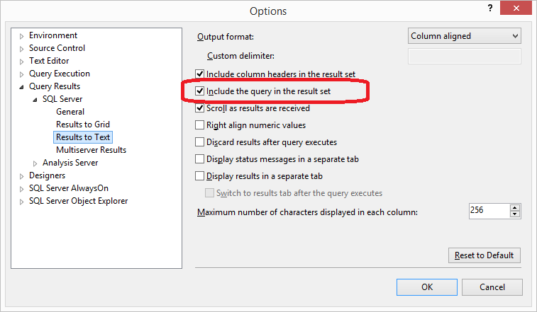
Include query in result set
Makes a quick report that also includes a record of what query you used to generate the results
Auditors love this
“Proves” what query generated the results
One-time ad-hoc queries for end users
Never lose the script you used to generate the output
One-time queries are rarely one-time—they’ll want it again next month or next year
Notes:
Setting is available for both “Results to Grid” and “Results to Text” … With “Results to Text” it will appear on your Results tab. With “Results to Grid” it will appear on the Messages tab.

Slide 34
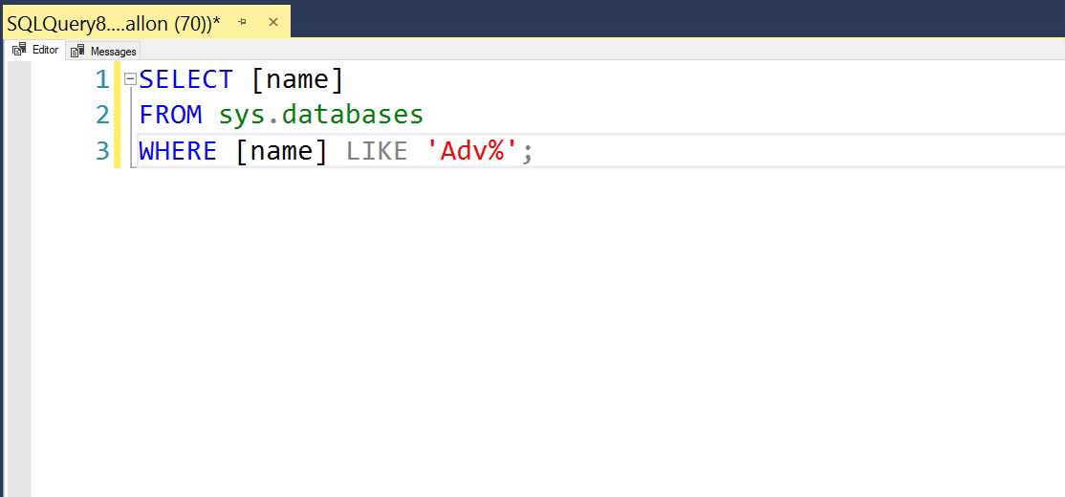
Include query in result set

Slide 35
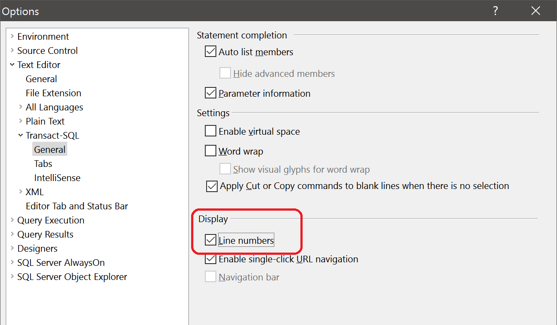
Line numbers in SSMS

Slide 36
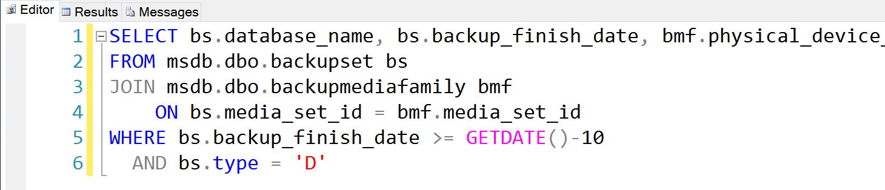
Line numbers in SSMS

Slide 37
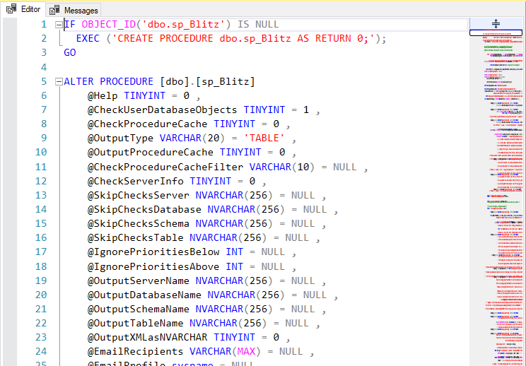
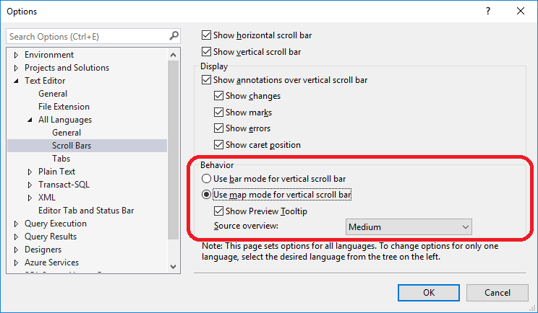
Scroll bar “map mode”

Slide 38
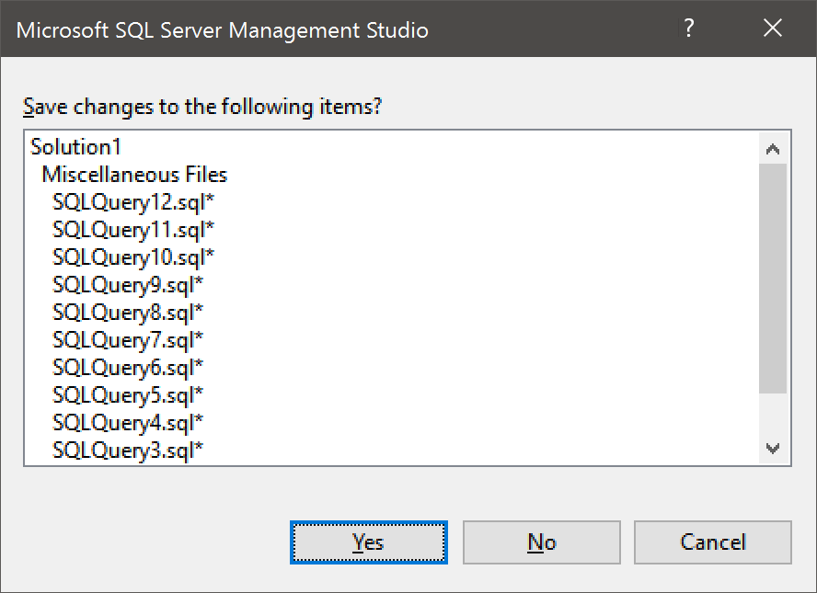
Save changes to the following items?
Notes:
This is what it looks like every time I quit SSMS. About once per year, I actually want to save something

Slide 39
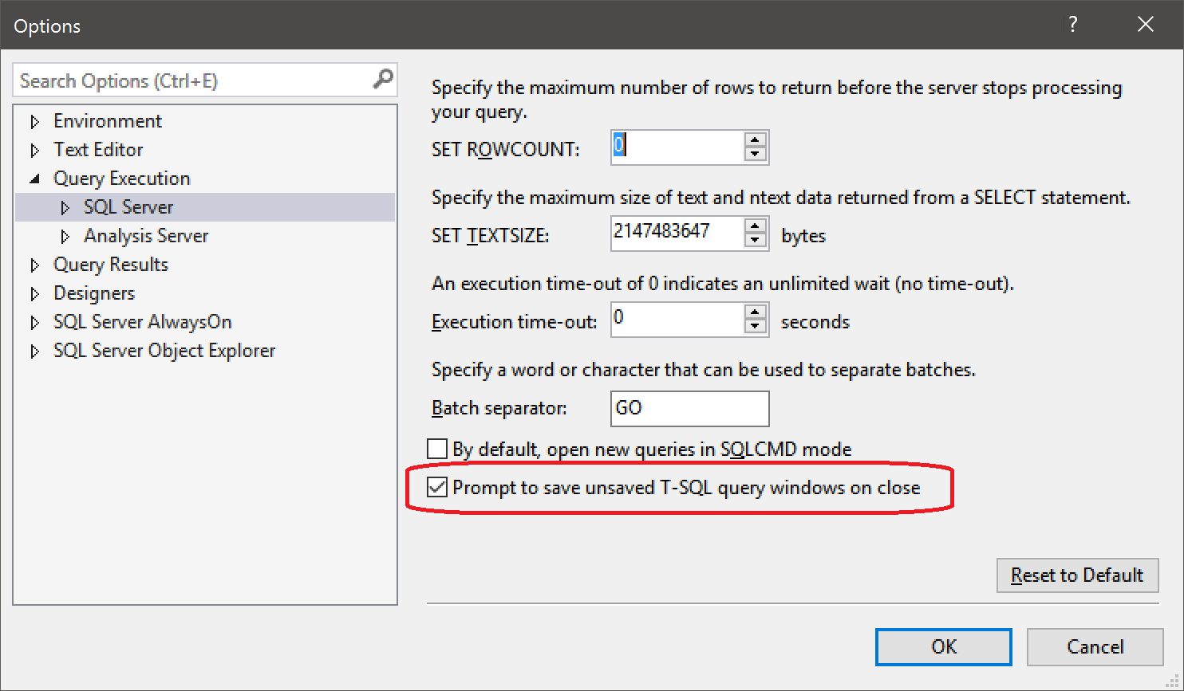
Don’t bother saving
Notes:
New to SQL 2016

Slide 40
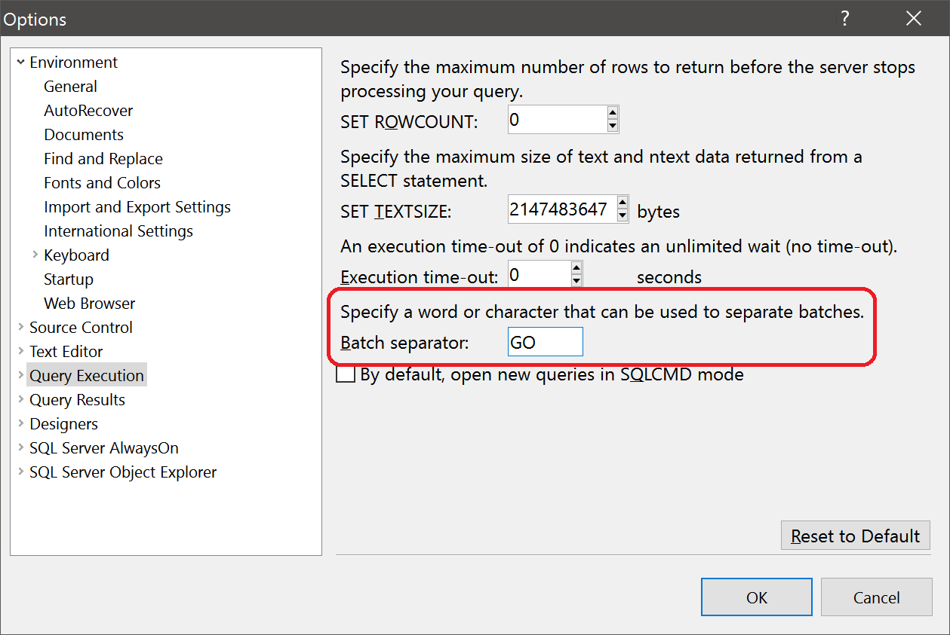
GO
You can change the batch separator in SSMS to be something other than GO
Notes:
OK… so… WHY would you want to do this?

Slide 41
GO have some fun
I can’t think of any reason to do this
Change your coworker’s batch separator to “SELECT”
DO NOT CHANGE YOUR COWORKER’S BATCH SEPARATOR TO “WHERE”
Hilarious with SELECT
Not so funny for DELETE
Notes:
It’s all fun and games until someone tries to DELETE

Slide 42
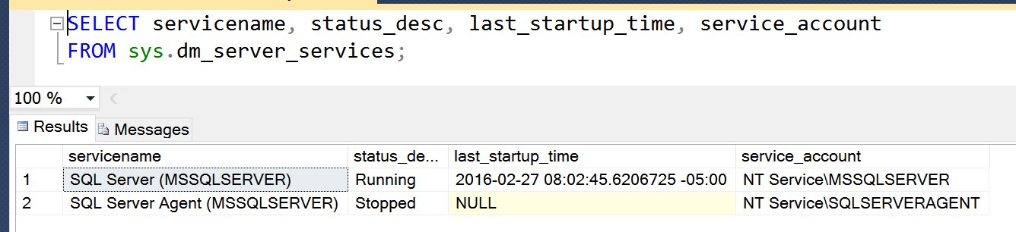
How to find the Service Account
sys.dm_server_services
Introduced in SQL Server 2008R2 SP1
Notes:
Shows all installed SQL Server services, plus startup time.
Will include SSIS, SSAS, SSRS, Full-Text search, etc

Slide 43
What about Azure Data Studio?

Slide 44
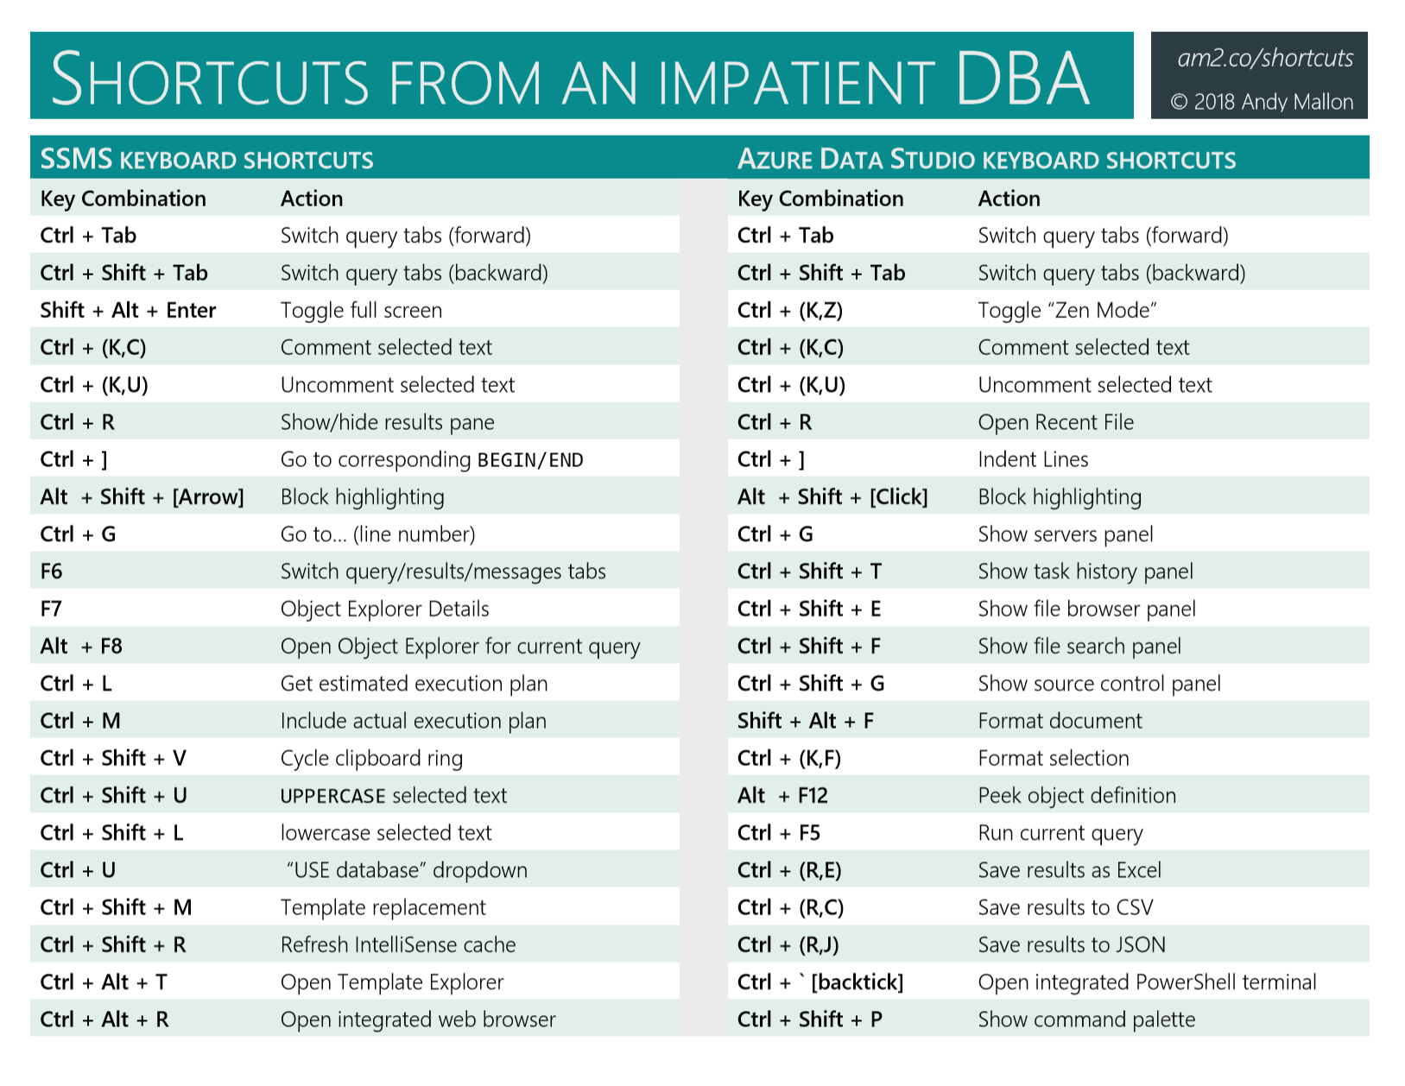
Azure Data Studio shortcuts

Slide 45
Woo hoo! They’re the same!

Slide 46
WTF? All new shortcuts??!!

Slide 47
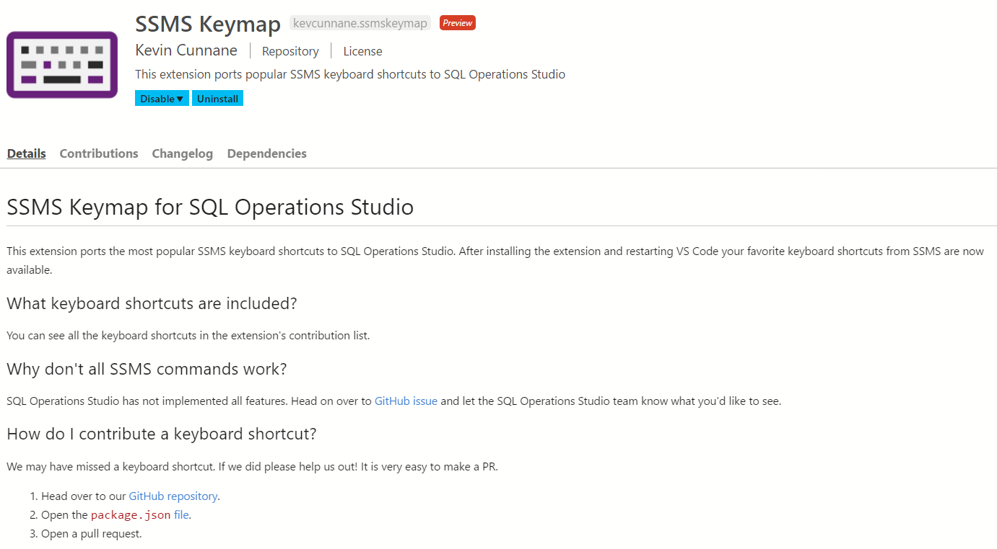
SSMS Keymap
Azure Data Studio extension
by Kevin Cunnane, Engineering Manager, Microsoft
This extension ports the most popular shortcuts to Azure Data Studio

Slide 49
Windows keyboard shortcuts

Slide 50
Windows Shortcuts
Win + R
Win + E
Win + L
Win + T
Ctrl + Alt + End
Win + X (Win 8+, 2012/R2)
Ctrl + Scroll wheel
Run…
Windows Explorer
Lock Windows
Focus on Taskbar
Ctrl + Alt + Del (for RDP)
Power User menu
Zoom in/out

Slide 51
Win + [Arrow keys]
Win + UP
Maximize window
Win + Down
Restore (when maximized)
Minimize (when not maximized)
Win + Left/Right
Dock on Left/Right size of current monitor

Slide 52
Virtual Desktops (Windows 10)
Win + CTRL + D
Create virtual desktops
Win + CTRL + LEFT/RIGHT
Switch to next/previous virtual desktop
Win + Tab
“Task view”
Select any desktop or any window on current desktop
Win + CTRL + F4
Close current virtual desktop

Slide 53
Windows shortcuts & tricks

Slide 54

Shortcut to a better Control Panel
Create a folder and name it this:
Admin.{ED7BA470-8E54-465E-825C-99712043E01C}
The “Magic GUID” will create a folder called “Admin” that contains a direct shortcut to every single Control Panel option
Nothing special about the word “Admin”
Flattens all the nested Control Panel pages into a single list
Works on all currently supported versions of Windows
Sorry XP users!
Notes:
AKA “God Mode”
Somehow, I missed that this has been a feature since Windows 7

Slide 55
Shortcut to a better Control Panel
Microsoft publishes a list of “Canonical Names of Control Panel Items”
http://go.am2.co/MagicGuids
This doesn’t work with new-style Windows 10 Settings
Windows Update.{36eef7db-88ad-4e81-ad49-0e313f0c35f8}
This doesn’t work on Windows 10
MPIO.{AB3BE6AA-7561-4838-AB77-ACF8427DF426}
Server OS version only

Slide 56
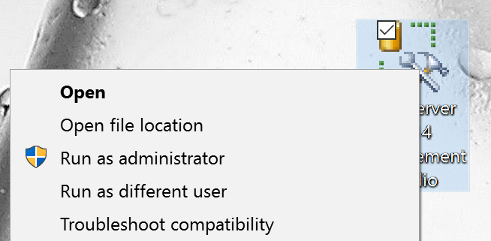
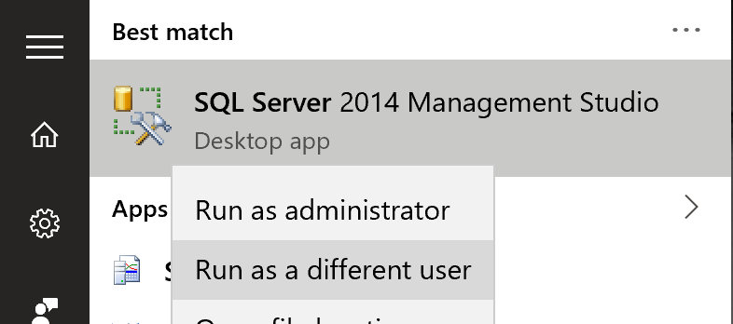
Run as (a) different user
Shift + Right-Click
Right-Click from Win10 Start Menu
Notes:
This is how you can run SSMS as a different user, and use trusted authentication. Multiple domain accounts? Multiple domains? I have two domain accounts at work: “amallon” and “amallon.admin”.
This is also a great example of how consistent Microsoft is in the UI design. Where’s Allan Hirt?

Slide 57
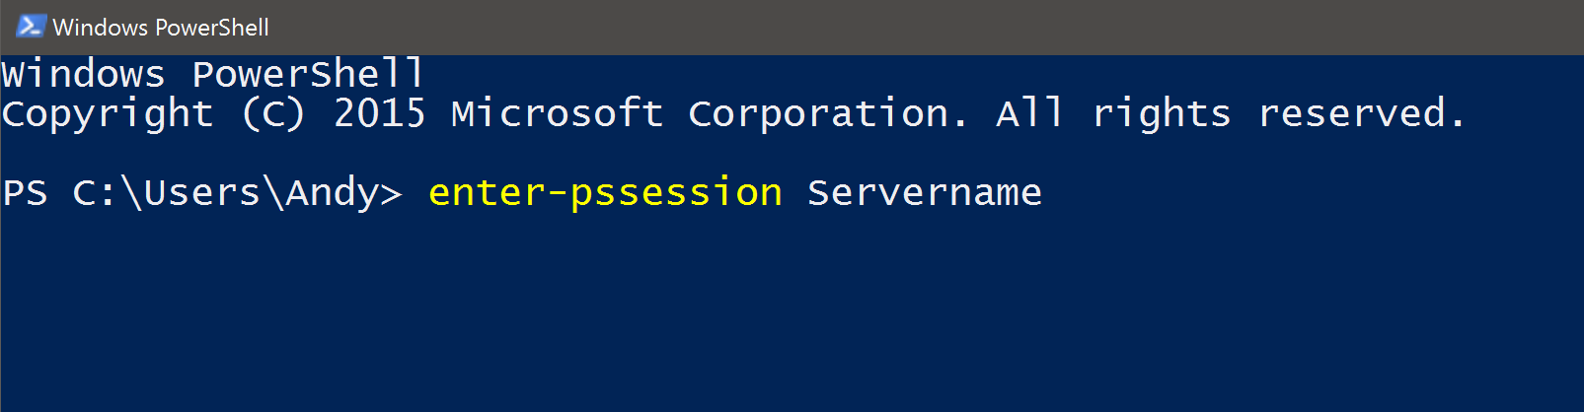
Powershell: Enter-PsSession
Remote Desktop for PowerShell
Starts an interactive session with a remote computer
Notes:
Allows you to interact with another machine from the PowerShell prompt on your machine

Slide 58
Is Lock Pages In Memory enabled?
Whoami /priv
Remember, you need to do this as the service account
EXEC xp_cmdshell 'whoami /priv'
If enabled
If no proxy account

Slide 59
Is Lock Pages In Memory enabled?
Combine three shortcuts:
Run PowerShell prompt as a different user
Shift + Right-Click
Use Enter-PsSession to start a session on the server
Use whoami /priv to get your answer

Slide 60
Is Lock Pages In Memory enabled?
PS C:\> Enter-PsSession ServerName
[ServerName]: PS C:\> whoami /priv
PRIVILEGES INFORMATION
----------------------
Privilege Name State
============================= ========
SeLockMemoryPrivilege Enabled
SeManageVolumePrivilege Enabled
Notes:
There will be a bunch of stuff in the output. Look for “SeLockMemoryPrivilege” … if it’s not there, that means it’s not enabled.
You can also check for “SeManageVolumePrivilege” – “Manage Volume Maintenance Tasks” – The permission necessary for Instant File Initialization (IFI)

Slide 61
Blue Screen on Demand
HKLM\System\CurrentControlSet\Services\ kbdhid\Parameters
Create a value named CrashOnCtrlScroll
Set it equal to a REG_DWORD value of 0x01
Hold right-Control & tap Scroll Lock twice
From David Klee
http://www.davidklee.net/2015/11/30/summon-blue-screens-of-death-for-testing-purposes-only-of-course/

Slide 62
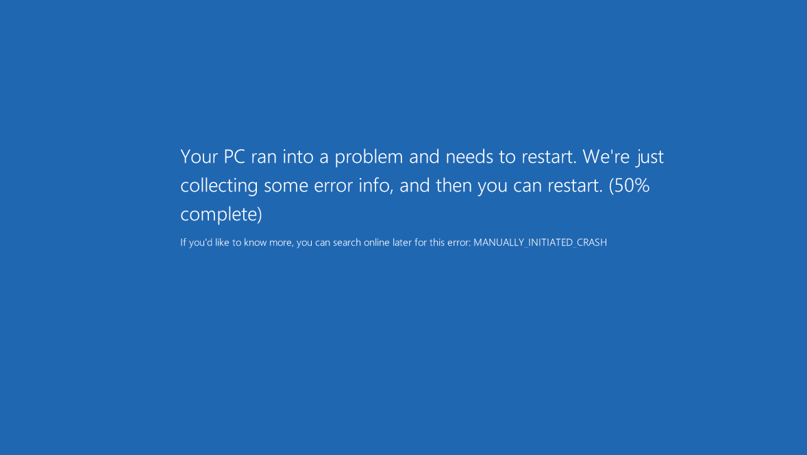

Slide 63
Pause the SQL Server service
Allows connected users to continue work
Prevents new connections
Error: 17142, Severity: 14, State: 0. SQL Server service has been paused. No new connections will be allowed. To resume the service, use SQL Computer Manager or the Services application in Control Panel.
Error: 18456, Severity: 14, State: 13. Login failed for user ''. Reason: SQL Server service is paused. No new connections can be accepted at this time. [CLIENT: <local machine>]
From Tom LaRock
http://thomaslarock.com/2016/01/pause-sql-server-service-before-restarting/
Notes:
You might want to do this before planned maintenance, rather than killing sessions
Useful during an emergency, too…letting user connections bleed off

Slide 64
Your turn!
What are your favorite shortcuts & tricks?
Notes:
Teach me something!

Slide 65

Slides + more
AMtwo.co/shortcuts-ppt

Slide 66
Questions?

Slide 67
Resources
Blog posts about these tips
AMtwo.co/shortcuts
These slides + cheat sheet
AMtwo.co/shortcuts-ppt
SSMS Keymap for SQL Ops Studio
github.com/kevcunnane/ssmskeymap
Additional information referenced in slides
AMtwo.co/RemapSSMS
go.am2.co/MagicGuids
davidklee.net/2015/11/30/summon-blue-screens-of-death-for-testing-purposes-only-of-course/
thomaslarock.com/2016/01/pause-sql-server-service-before-restarting/

